Slide 1
The GW approximation
Daniel Mejia-Rodriguez
Edoardo Aprà
Niri Govind
2023 CyberWorkshop

Slide 2
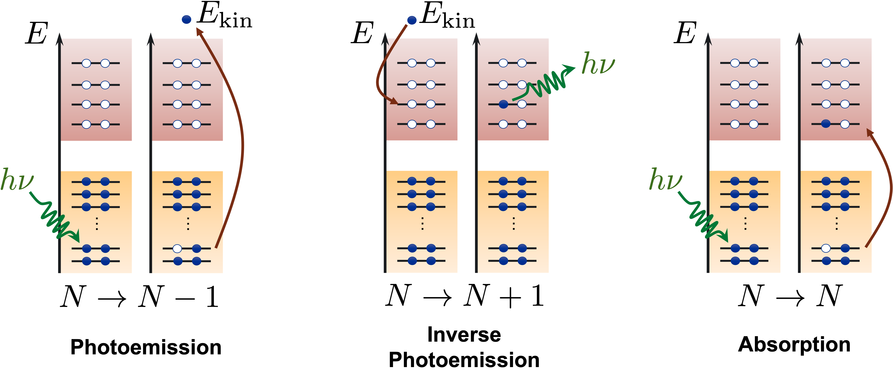
How do we study electronic excitations?

Slide 3
How do we study electronic excitations?
Charged
Neutral

Slide 4
How do we study electronic excitations?
In a quantum mechanical framework that describes interacting electrons and nuclei in the presence of a time-dependent external field.
Wavefunctions-based methods (HF, CASSCF, CC, … )
Green’s-function-based methods (GW, GFCC, … )
Density-based methods (DFT, TD-DFT)
Compromise between the accuracy of results and computational effort

Slide 5
Optical gap, fundamental gap, and orbital gap
Energy
Koopman’s theorem

Slide 6
Optical gap, fundamental gap, orbital gap, and derivative discontinuities
Energy
Perdew, Parr, Levy, Balduz
PRL 49, 1691 (1982)
Levy
PRA 52, R4313 (1995)
Kraisler, Hodgson, Gross
JCTC 17, 1390 (2021)

Slide 7
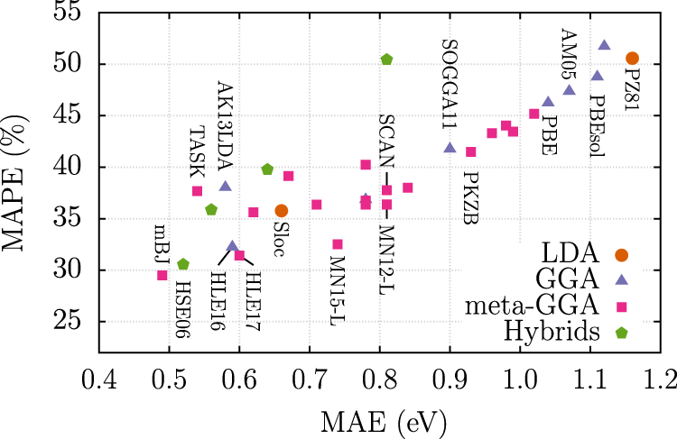
Orbital gaps in DFT
Adapted from PRL 96 226402 (2008)
npj Computational Materials 6, 96 (2020)
Notes:
2-- 226402

Slide 8
How to improve within DFT?
Include effects of the derivative discontinuity
PRL 110, 033002 (2013)
JCP 157, 114109 (2022)

Slide 9
Beyond DFT: Green’s Function Many Body Theory

Slide 10
Green’s Function
Historically older than Hohenberg-Kohn theorems
The Green’s function is a natural generalization of the density and the one-body density matrix:
+ spin-space non-locality
+ time non-locality

Slide 11
Green’s Function
The field operators in the Heisenberg picture are related to those in the Schrödinger picture
T orders the operators from left to right in decreasing time (earliest on the right) with a -1 factor for each permutation (fermions)
Let 1=(x₁,t₁), 2=(x₂,t₂), and t₁>t₂:

Slide 12
Green’s Function
represents a state with one electron added in x₂ to the N-electron ground-state at time t₂.
Propagates the N+1-electron state from time t₂ to t₁.
represents the bra of the state with one electron added in x₁ to the N-electron ground-state at time t₁.
The final projection measures the overlap between the two N+1 states after a (t1-t2) time delay
The Green’s function describes the propagation of electrons and holes (i.e. missing electrons)

Slide 13
Green’s function Lehman amplitudes
Using the spectral decomposition of H
Addition Lehman amplitude
Addition energy

Slide 14
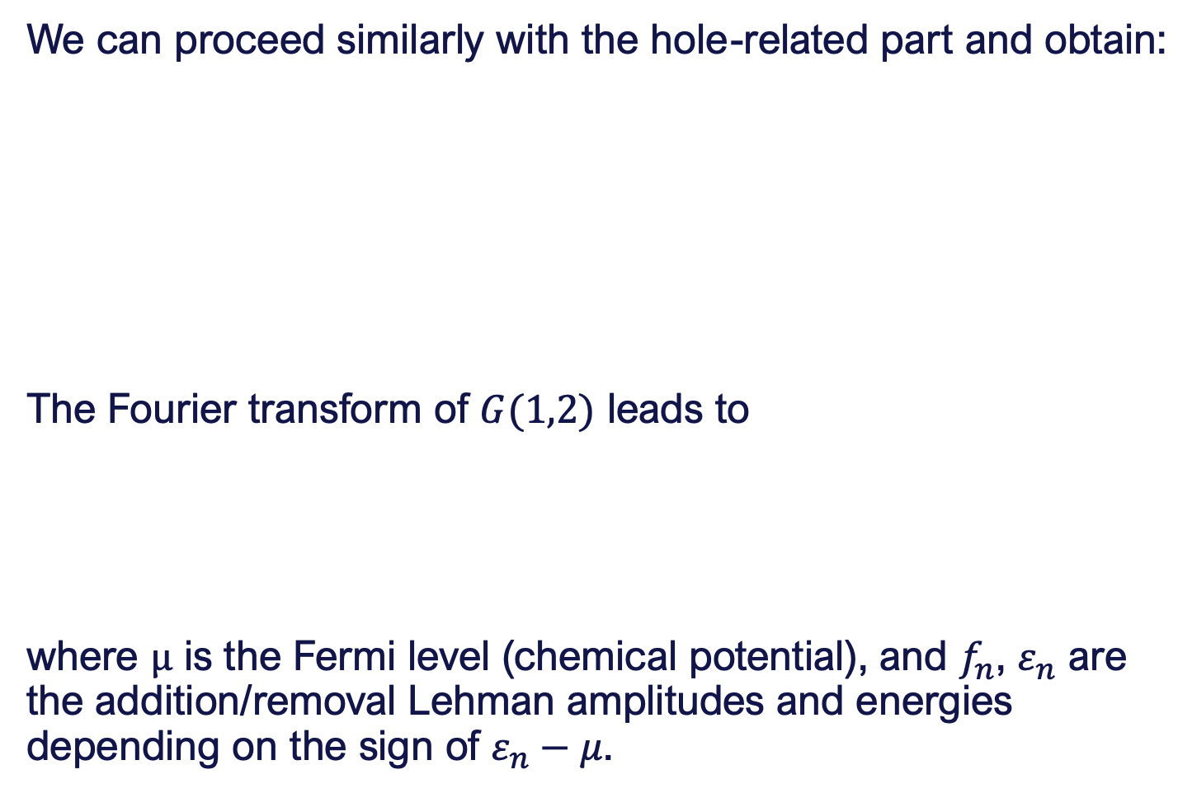
Green’s function Lehman amplitudes
We can proceed similarly with the hole-related part and obtain:
The Fourier transform of $G(1,2)$ leads to
where $μ$ is the Fermi level (chemical potential), and $f_{n}$, $ε_{n}$ are the addition/removal Lehman amplitudes and energies depending on the sign of $ε_{n}−μ$.

Slide 15

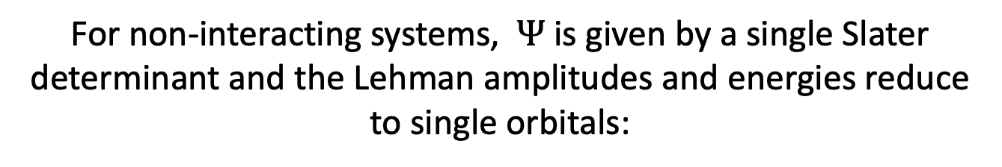
Green’s function
The poles of the Green’s function are the true addition/removal electronic energies of the $N$-electron system!
For non-interacting systems, $Ψ$ is given by a single Slater determinant and the Lehman amplitudes and energies reduce to single orbitals:
removal
addition

Slide 16
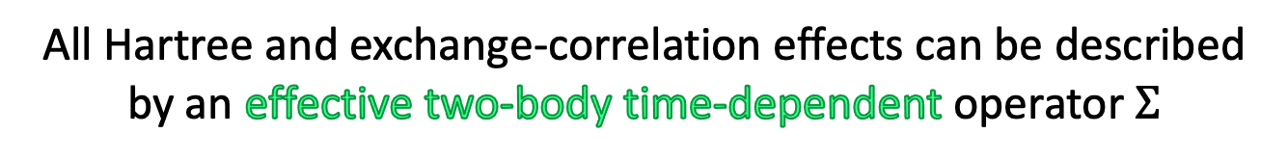
Equation of motion for the Green’s Function
The change of G with respect to one of its time arguments is
All Hartree and exchange-correlation effects can be described by an effective two-body time-dependent operator $Σ$

Slide 17
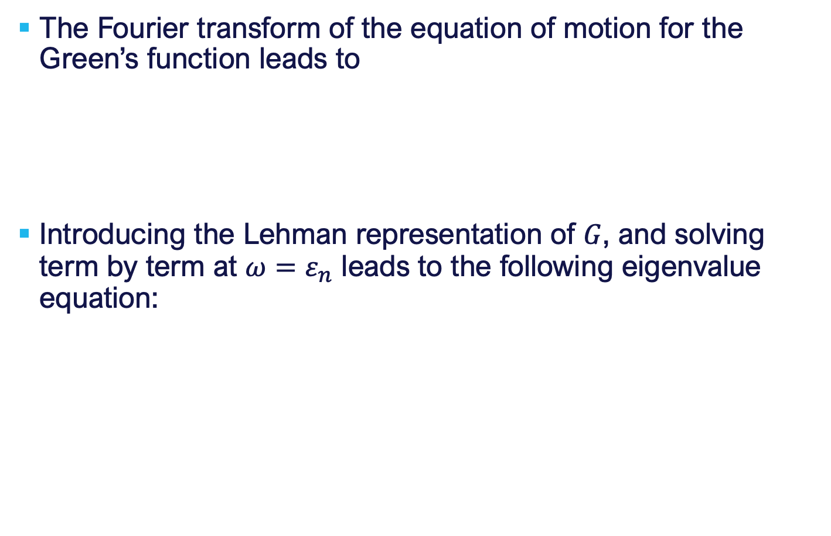
Equation of motion for the Green’s Function
The Fourier transform of the equation of motion for the Green’s function leads to
Introducing the Lehman representation of $G$, and solving term by term at $ω=ε_{n}$ leads to the following eigenvalue equation:
The true addition/removal energies are solutions of a simple one-body equation, but now the HXC operator depends on the energy of the state it is acting on

Slide 18
The GW approximation
Self-energy
Green’s function
Screened
Coulomb
Vertex Function
Polarizability
Phys. Rev. 139, A796 (1965)

Slide 19
GW calculations in practice
The input Green’s functions is built from Kohn-Sham eigenstates and eigenvalues.
The screened Coulomb interaction is obtained using either
The independent-particle polarizability
The interacting polarizability (neglecting exchange-correlation kernel)

Slide 20
GW calculations in practice GW flavours
Perturbative GW, one-shot GW, G₀W₀
One loop through Hedin’s pentagon
Output: quasiparticle energies
evGW or eigenvalue-only (partially) self-consistent GW
Several loops through Hedin’s pentagon
Lehman amplitudes are kept frozen
Output: quasiparticle energies
qsGW or quasiparticle (partially) self-consistent GW
Several loops through Hedin’s pentagon
Lehman amplitudes are updated using a Hermitian self-energy
Output: quasiparticle energies and amplitudes
scGW or (fully) self-consistent GW
Several loops through Heding’s pentagon
Lehman amplitudes are updated using the non-Hermitian self-energy
Output: quasiparticle energies and amplitudes

Slide 21
GW calculations in practice One-shot G₀W₀
Quasiparticle energies are updated
Lehman amplitudes are kept frozen

Slide 22
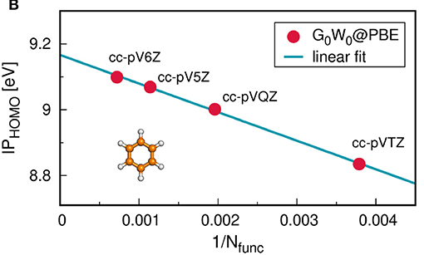
Convergence with basis set size
Convergence with respect to the number of occupied levels can be slow:
Chemical shifts converge rather fast (removal energies)
JCTC 18, 4919 (2022)
Notes:
4919

Slide 23
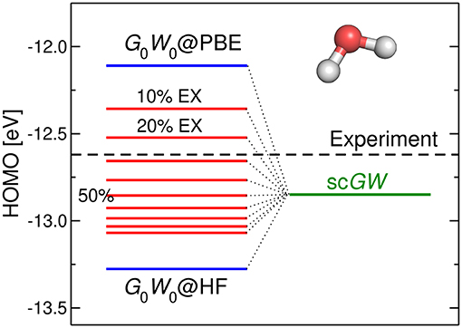
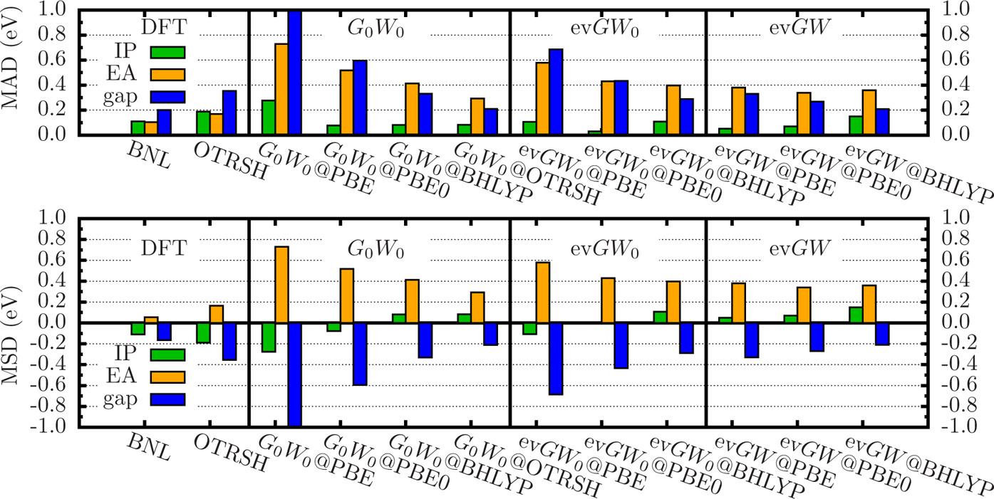
Starting-point-dependence
G0W0 has a strong starting-point dependence since G0 and W0 are built from Kohn-Sham inputs
Partially self-consistent schemes alleviate the issue but does not solve it
Front. Chem. 7, 00377 (2019)
JCTC 12, 2834 (2016)

Slide 24
Gaps
Energy
The GW method gives approximate fundamental gaps
It misses excitonic binding effects

Slide 25

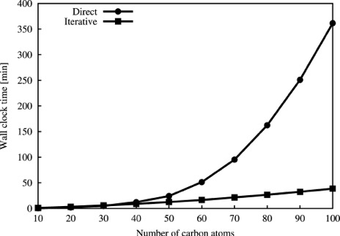
GW Implementation
CD-GW
AFF-GW
Contour Deformation
Analytical Full Frequency
Variational Fitting
MINRES
ELPA
SIAM J. Numer. Anal. 12, 617-629, (1975)
Parallel Computing 37, 783 (2011)
J. Chem. Theory Comput. 11, 1493 (2015)
JCTC 17, 7504 (2021)

Slide 26
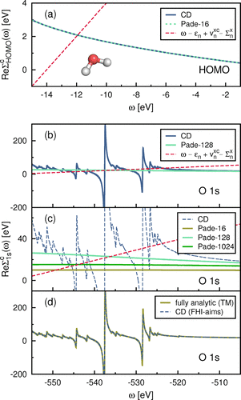
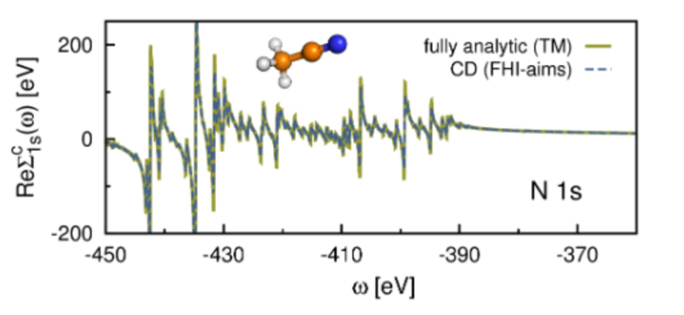

GW Implementation Numerical stability
Valence
Core

Slide 27
GW implementation Performance
Core + Valence
JCTC 17, 7504 (2021)

Slide 28
Examples

Slide 29
N₂ Ionization potential with GW
This input directs NWChem to compute the N₂ ionization potential using GW with default options:
Analytical
Newton solver
Only HOMO
geometry
N 0.0 0.0 -0.545
N 0.0 0.0 0.545
symmetry c1
end
basis "ao basis" spherical
* library def2-qzvp
end
basis "cd basis" spherical bse
* library def2-universal-jkfit
end
dft; xc mgga_x_r2scan mgga_c_r2scan; end
task dft gw
GW needs a fitting basis
cd basis --> used during SCF and GW
ri basis --> used only in GW
Explore the starting point dependence by using different exchange-correlation approximations

Slide 30
GW input block options
gw
[rpa] # Computes RPA energy
[first <integer ifirst, default 1>] # Start counting from orbital <ifirst>
[core] # Count from orbital <ifirst> upwards
[eta <float>] # Imaginary infinitesimal
[convergence <float thresh, default 0.005> [eV || hartree]]
[evgw <integer maxiter, default 4>] # Perform evGW partial self-consistent # calculation
[evgw0 <integer maxiter, default 4>] # Perform evGW0 partial # self-consistent calculation
[method [cdgw || analytic]] # Method to obtain Sigma = GW # convolution
[solver [newton || graph]] # Quasiparticle equation solver
[states [alpha [occ <integer, default 1>] [vir <integer, default 0>]]
[states [beta [occ <integer, default 0>] [vir <integer, default 0>]]
end

Slide 31
N₂ Ionization potential with GW
geometry
N 0.0 0.0 -0.545
N 0.0 0.0 0.545
symmetry c1
end
basis "ao basis" spherical
* library def2-qzvp
end
basis "cd basis" spherical bse
* library def2-universal-jkfit
end
dft; xc mgga_x_r2scan mgga_c_r2scan; end
task dft gw
Add a GW input block to request the calculation of 5 occupied quasiparticle energies and 5 virtual quasiparticle energies.
Modify the input to compute both 1s core-level binding energies only
Modify the input to perform an evGW0 calculation with 5 iterations. Use the option –1 to compute all occupied and all virtual orbitals

Slide 32
Analytical vs CDGW
geometry
C -1.2131 -0.6884 0.0000
C -1.2028 0.7064 0.0000
C -0.0103 -1.3948 0.0000
C 0.0104 1.3948 -0.0000
C 1.2028 -0.7063 0.0000
C 1.2131 0.6884 0.0000
H -2.1577 -1.2244 0.0000
H -2.1393 1.2564 0.0000
H -0.0184 -2.4809 -0.0000
H 0.0184 2.4808 0.0000
H 2.1394 -1.2563 0.0000
H 2.1577 1.2245 0.0000
symmetry c1
end
Use the PBE0 hybrid functional with the def2-tzvp basis set to compute the ionization potential of benzene with both the analytical and the CDGW methods

Slide 33
Questions?

Slide 34
Thank you

